Slide 1


Tourism Management
Website Project
Group 4:
1. Koiy Bottra(Leader)
2. Oum Soknang
3. Chhay Lang
4. Smai Phouchhet
5. Ly Visal

Slide 2
I. Project Objective
In this modern era of the internet, almost all of us rely on website from small to big tasks. Well, Tourism management website is one of the popular website that considered by Everyone ,because easy to access and communicate though wbsite.
Why we choose this project? So, Our group decide to make a Tourism management website to make it easy to manage some work of Traveling System in easy way.
What is the project about? We sell the ticket for Tourist and They can observe the place , know about the place they want to go through our website.

Slide 3

II. ProjectBackground
Tourism Management website great for :
Essay to manage request ticket for traveling
Easy for tourist take a look around the interesting place in website.
Save time
And share to their friends through social Media.
Notes:
Please take a look at project objective. I’m not sure is it ok or not

Slide 4



IV. Software requirements
Window 10
Visual Studio Code
Xampp

Slide 5

IV. Website Platform :

Slide 6
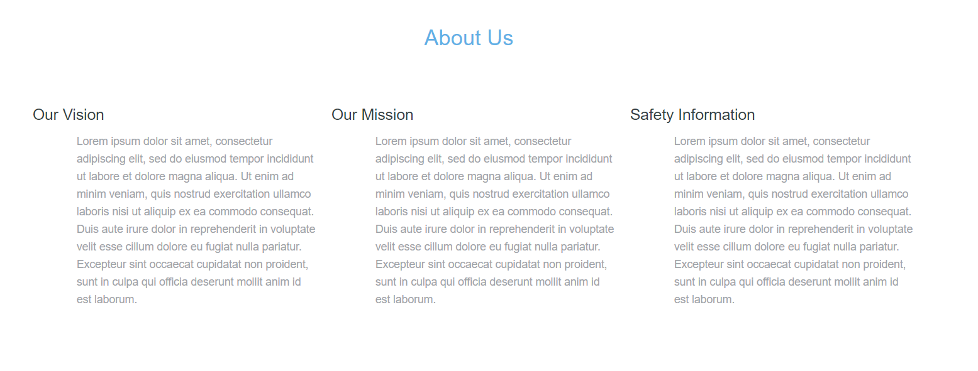
About Us

Slide 7
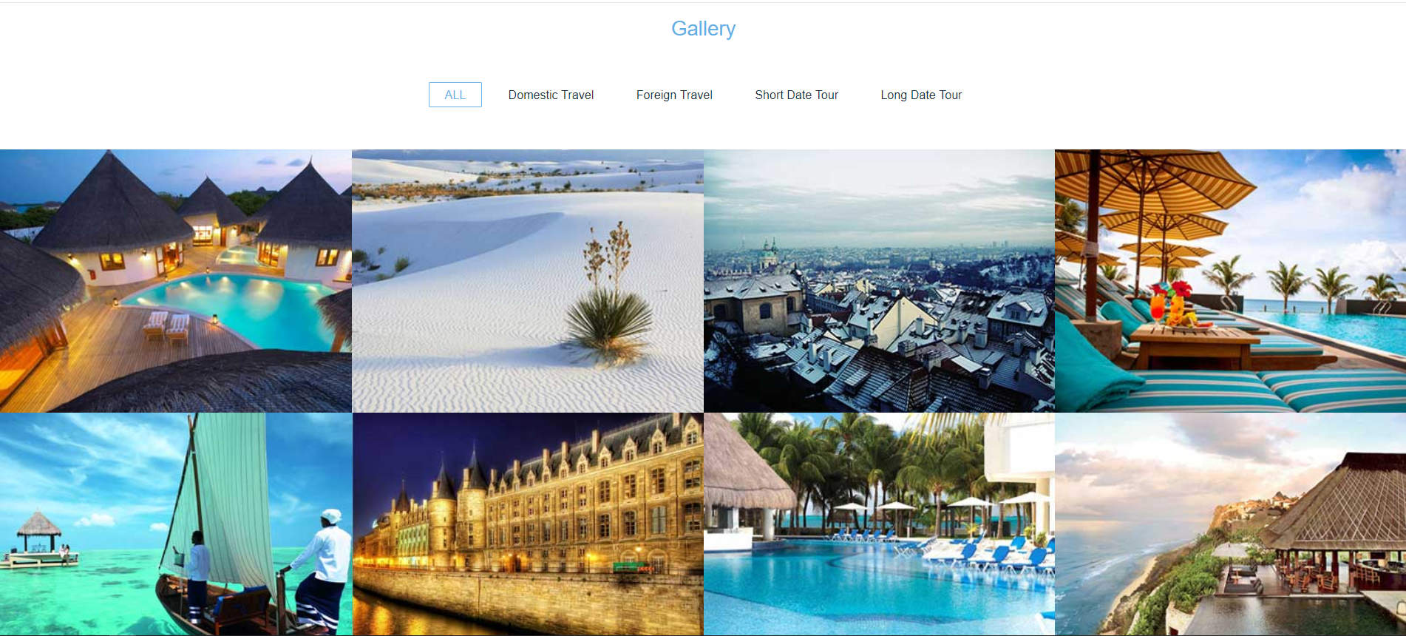
Gallery

Slide 8
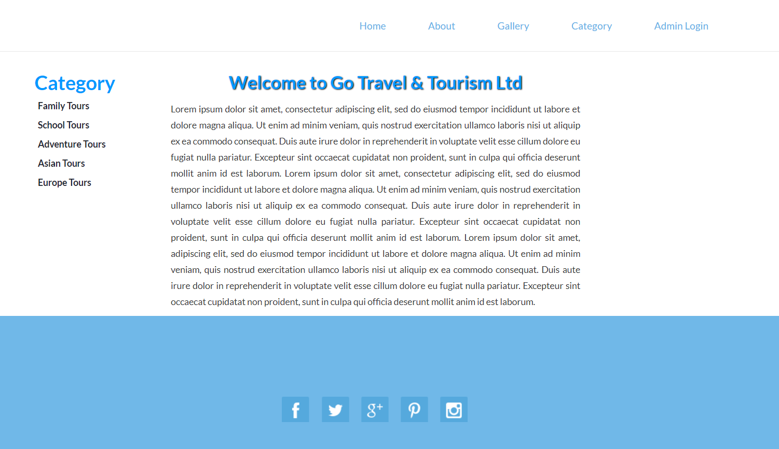
Categories

Slide 9
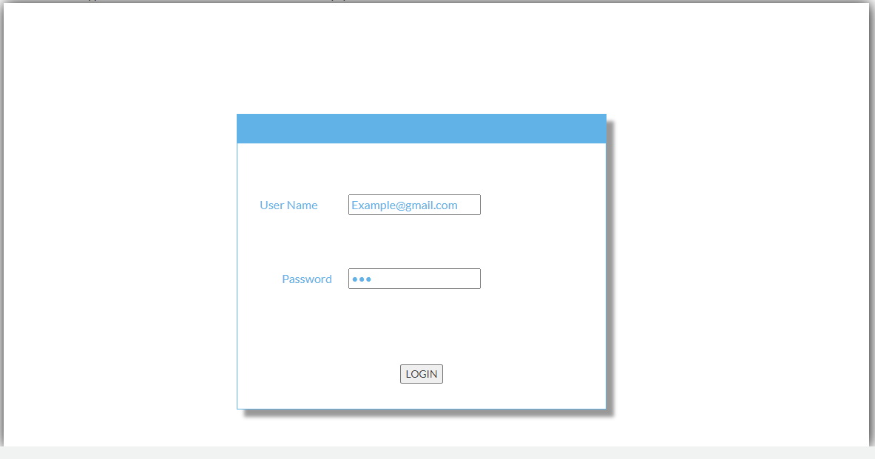
Login Form

Slide 10
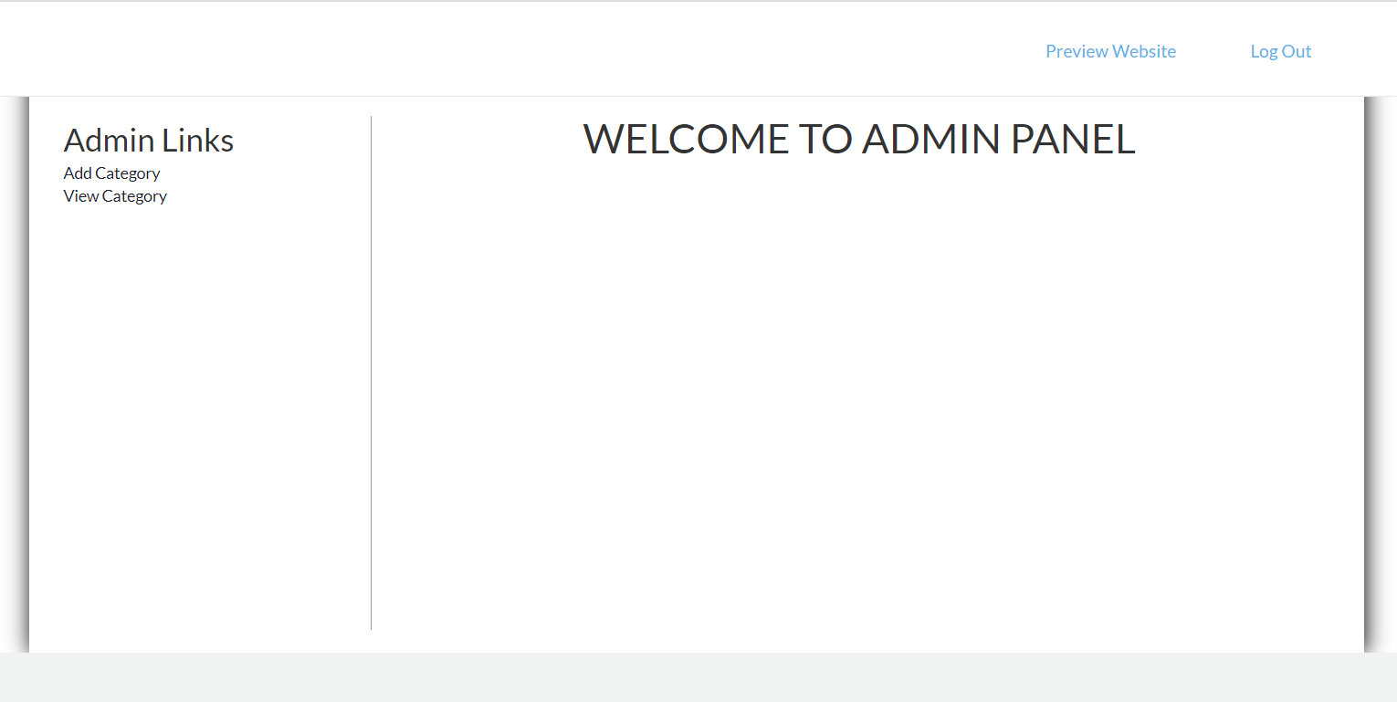
User Form

Slide 11
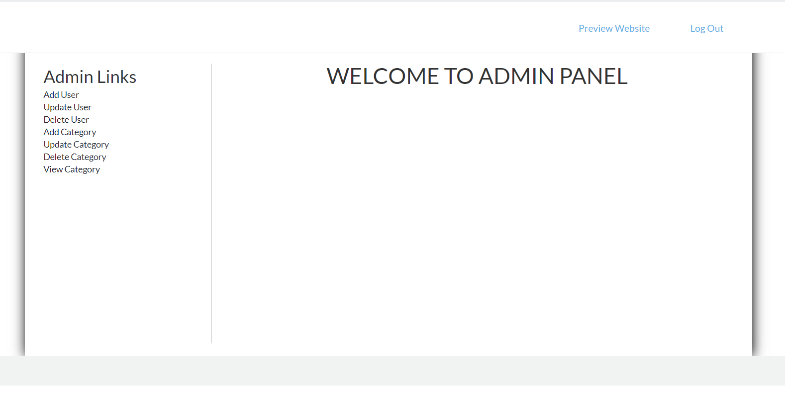
Admin Form

Slide 12
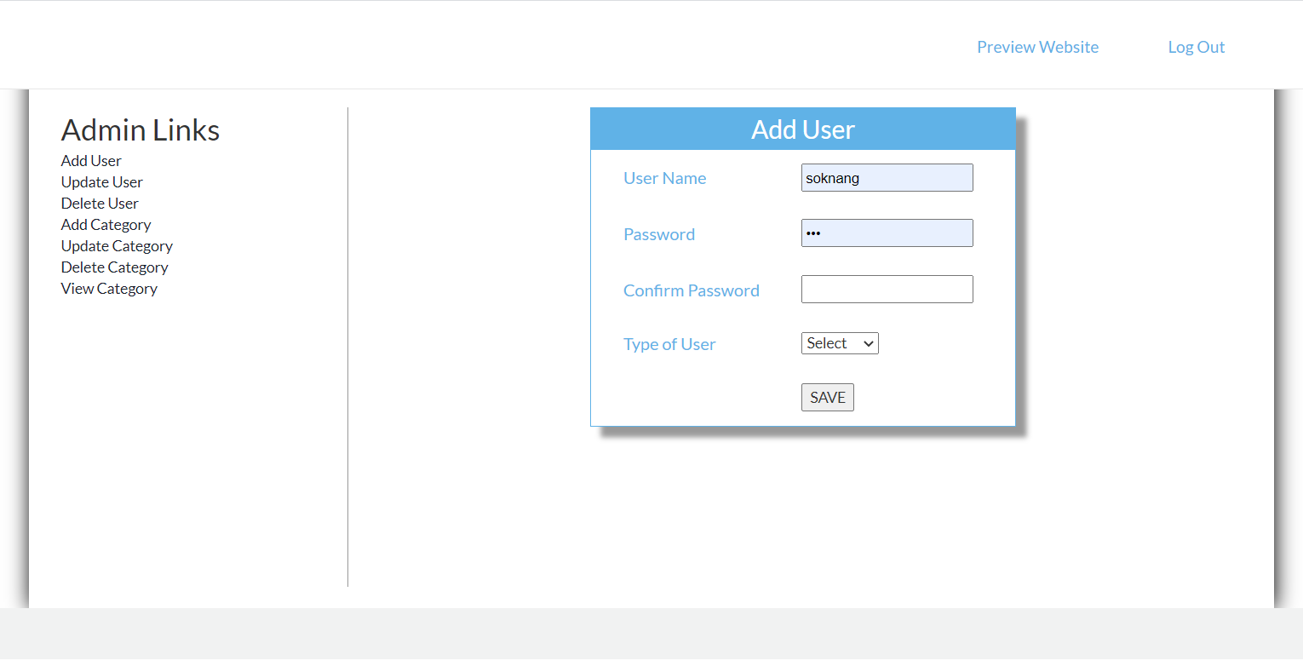
Add User

Slide 13
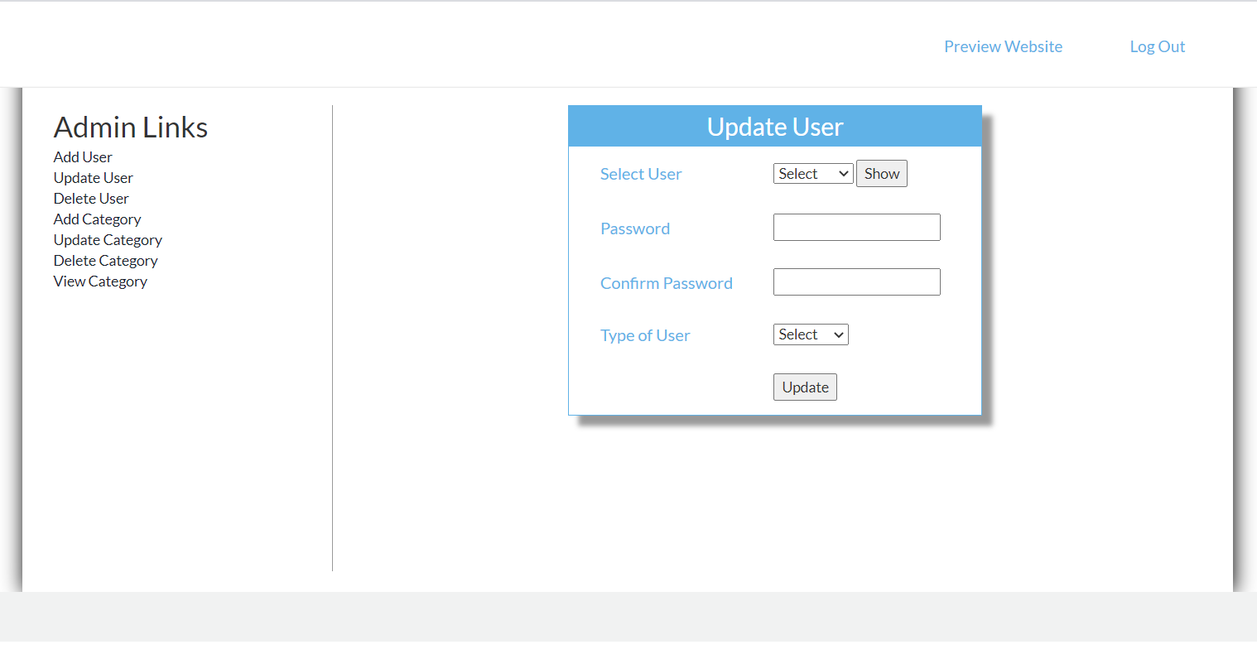
Update User

Slide 14
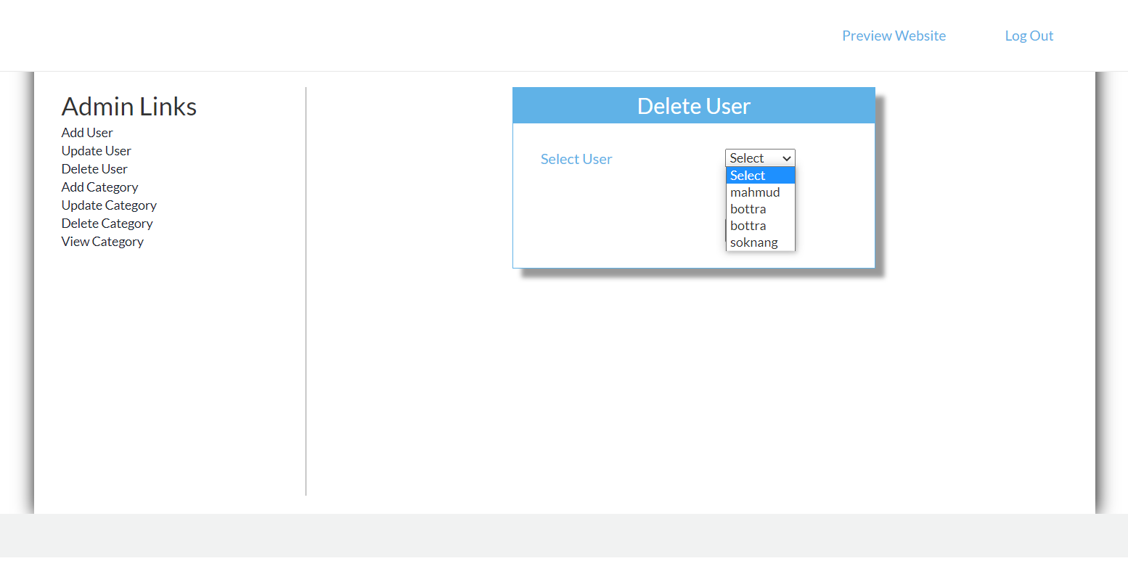
Detele User

Slide 15
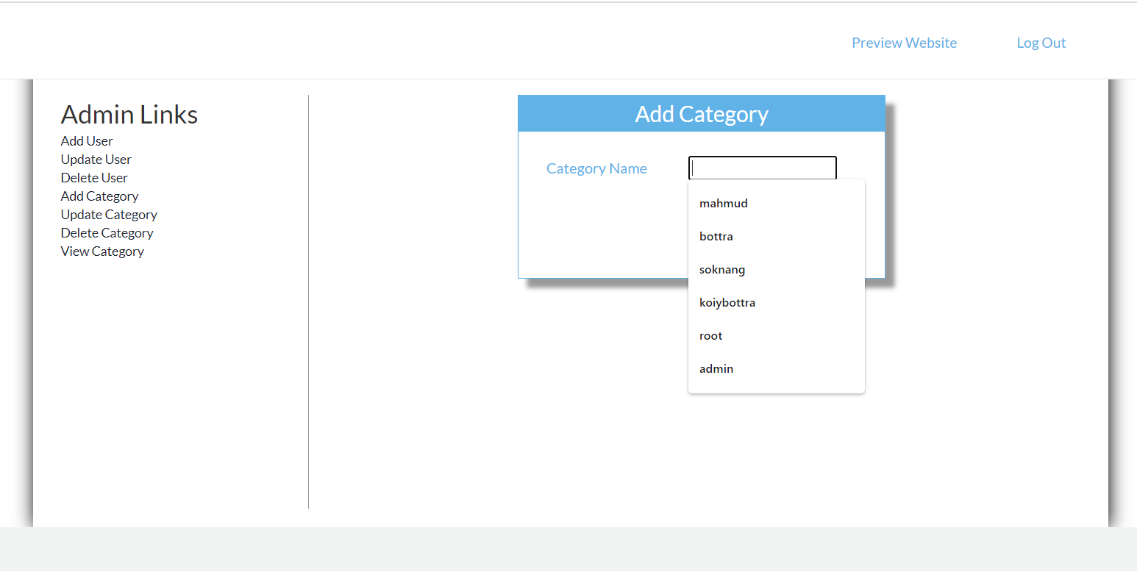
Add Category

Slide 16
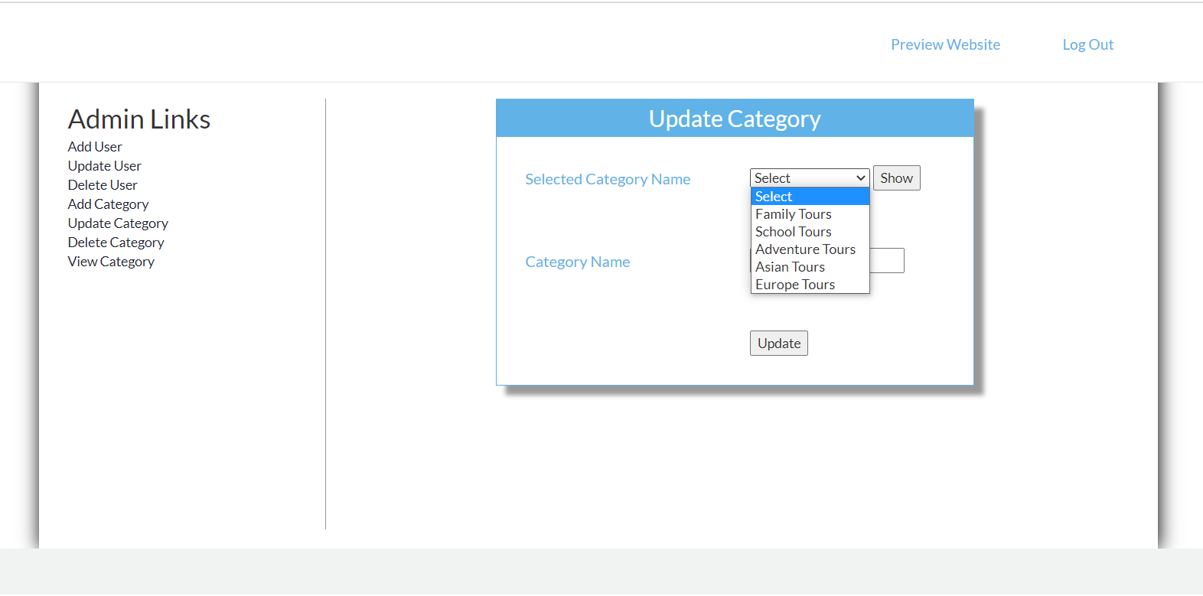
Update Category

Slide 17
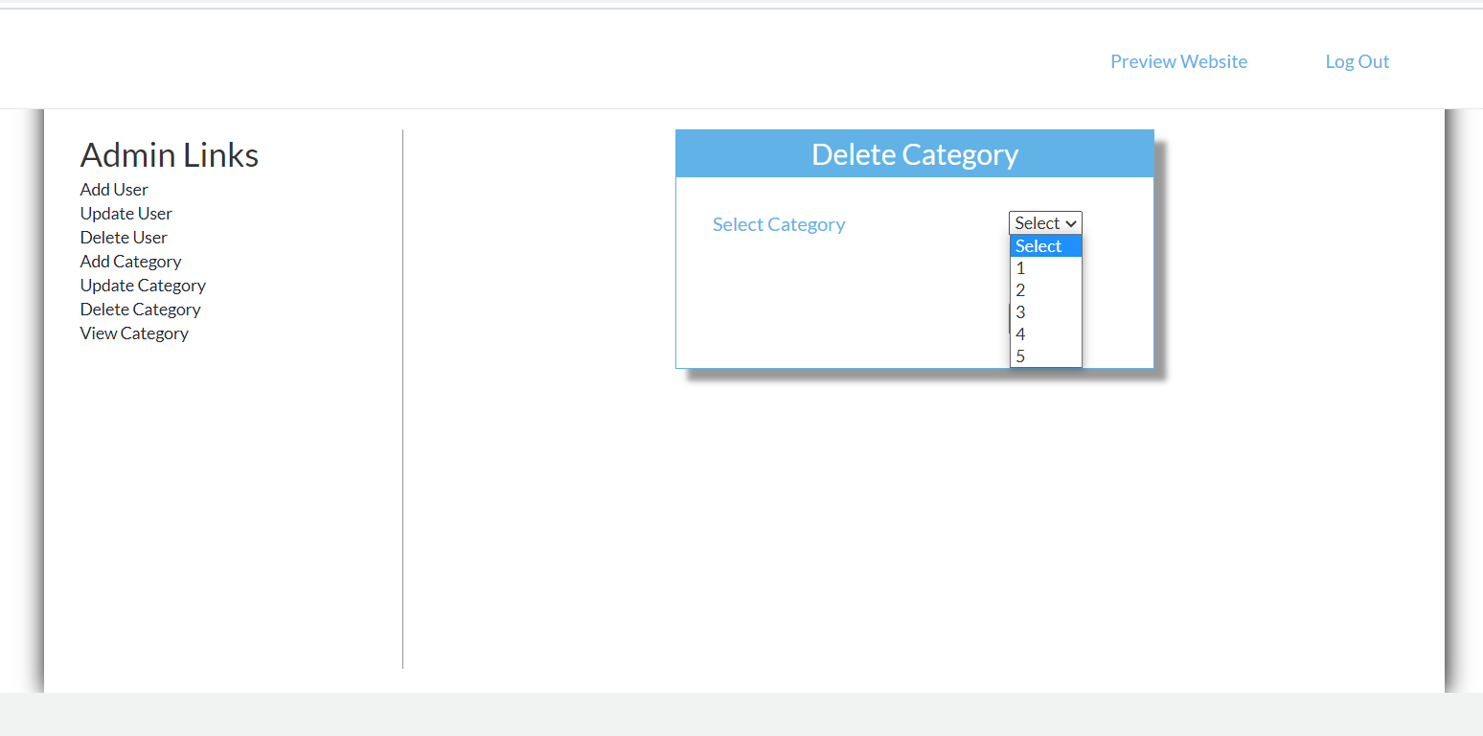
Delete Category

Slide 18
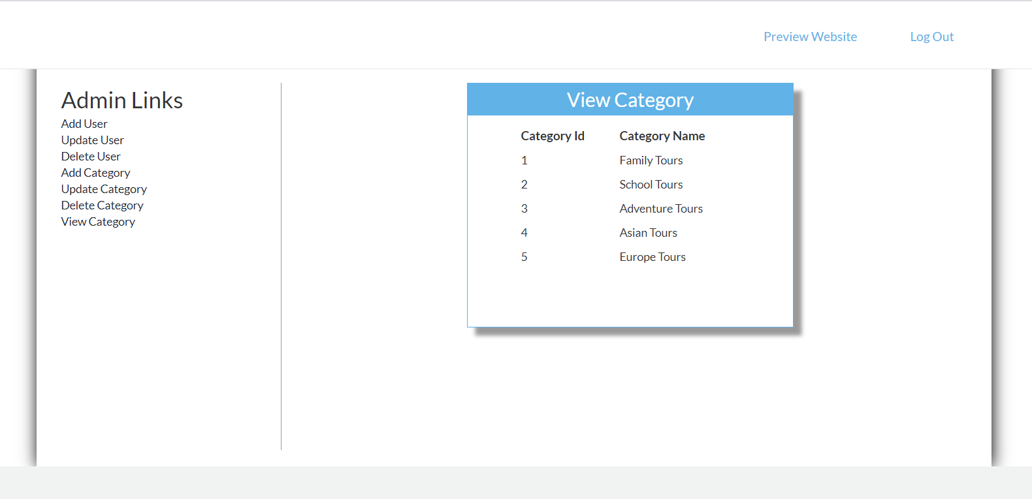
View Category

Slide 19
Thank You
Design -by || group3 members

